Slide 1
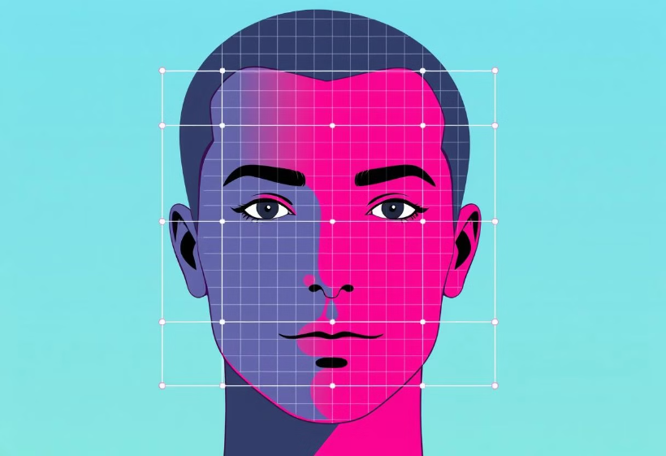
Face Detection & Recognition using Computer vision.
by Rudra Narayan Sahu.

Slide 2
Introduction to Computer Vision
What is Computer Vision?
How it Works
Computer vision is a field of artificial intelligence that enables computers to "see" and interpret images and videos like humans do.
Computer vision systems use algorithms to analyze visual data, extract features, and make predictions about the content of images and videos.

Slide 3
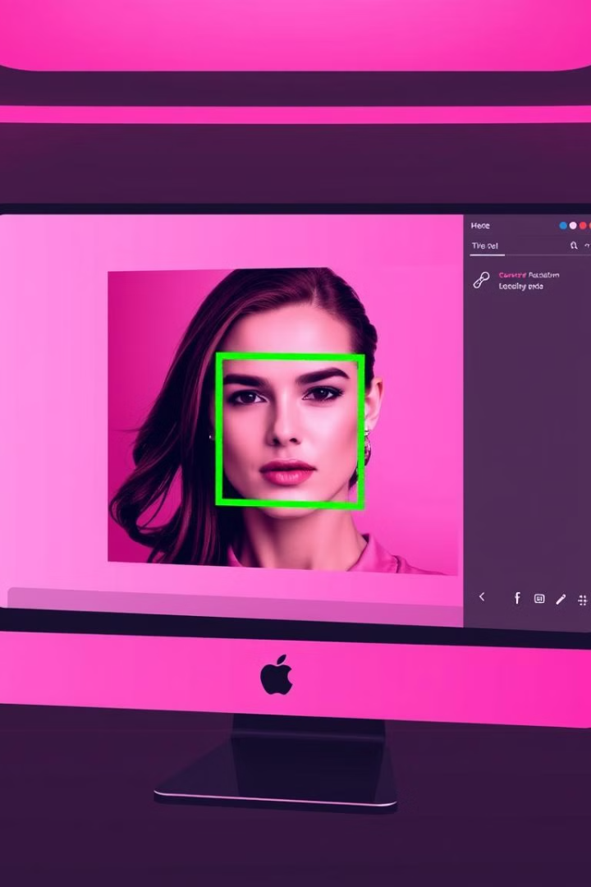
Fundamentals of Face Detection
1
1. Image Preprocessing
2
2. Feature Extraction
Preparing images for analysis, including resizing, normalization, and noise reduction.
Identifying key features in images, such as edges, shapes, and textures.
3
3. Classification
Categorizing objects based on extracted features, determining if a detected region is a face or not.

Slide 4
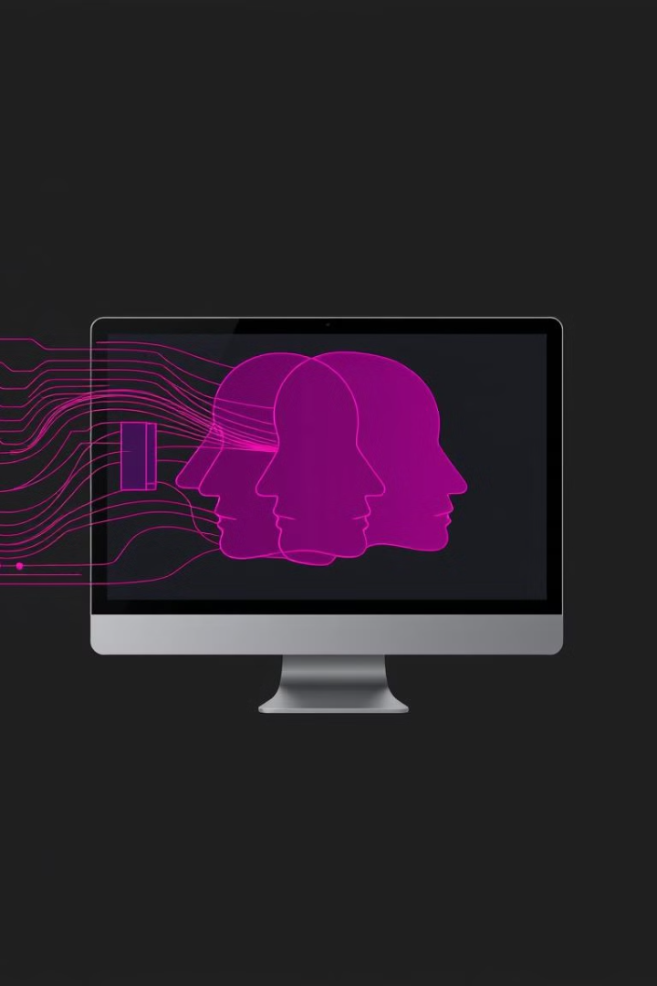
Techniques for Face Detection
Haar Cascades
Deep Learning
A traditional method relying on pre-defined features to detect faces efficiently.
Using artificial neural networks trained on large datasets for robust and accurate face detection.
Convolutional Neural Networks (CNNs)
A powerful deep learning technique that excels in image recognition tasks, including face detection.

Slide 5
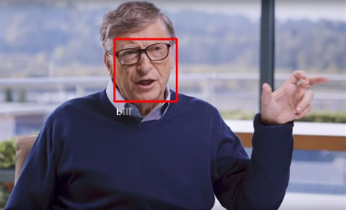
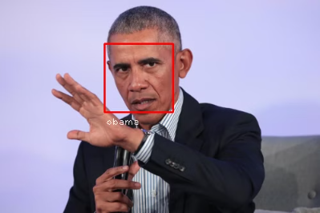
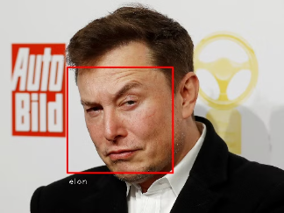
my code final image output
Driver Monitoring
Technology
Enhancing driver safety by detecting signs of drowsiness or distraction through face detection technology.
politician
space technology, facial recognition can play a role in astronaut identification and security protocols. It could be utilized to ensure that only authorized individuals are given access to sensitive areas within spacecraft or space stations. Moreover, facial recognition technology could assist in monitoring the well-being and emotional state of astronauts during long-duration missions, providing crucial insights for their mental health support.
Monitoring public figures and politicians to analyze their facial expressions and body language during speeches or public appearances, providing insights into their emotions and intentions.
Emotion Analysis
Analyzing facial expressions to determine emotions and sentiment, enabling enhanced customer insights.
Law Enforcement
Aiding in forensic investigations and identifying suspects through face matching algorithms and databases.

Slide 6

Real-World Case Studies
1
Smart Security Systems
Face detection improves security by identifying suspicious individuals in surveillance footage.
2
Access Control
Unlocking doors and granting access using facial recognition technology.
3
Retail Analytics
Analyzing customer behavior and patterns in retail settings using face detection technology.

Slide 7




Challenges in Face Detection
Occlusion
Faces may be partially hidden or obscured by objects.
Lighting Conditions
Variations in lighting can significantly affect face detection accuracy.
Pose Variation
Faces can be detected at different angles and orientations.

Slide 8




Applications of Face Detection
Facial Recognition
Unlocking smartphones, verifying identities, and providing secure access.
Mobile Payments
Facilitating secure online payments using facial recognition technology.
Social Media
Automating tagging of friends and family members in photos.

Slide 9




Conclusion and Future Developments
1
Advancements in AI
2
Improved Accuracy
3
Wider Adoption
4
Ethical Considerations

